Slide 1
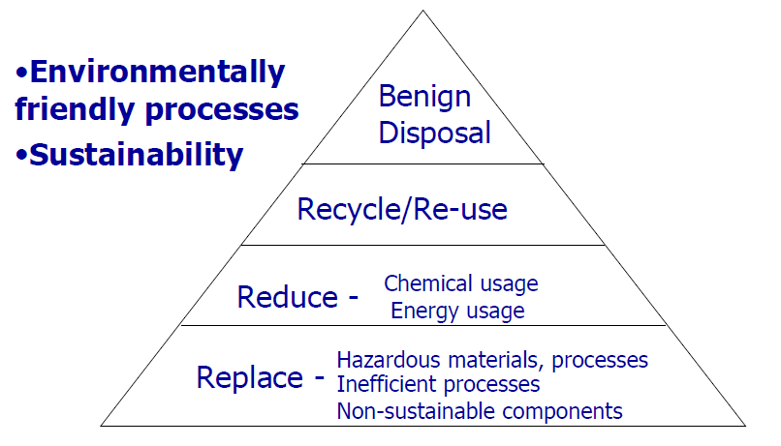

Green Chemistry
“Green Chemistry is the utilization of a set of principles that reduces or eliminates the use or generation of hazardous substances in the design, manufacture and application of chemical products.”
Green Chemistry: by Paul Anastas and John Warner

Slide 2
Role of chemistry in making life better
Life saving drugs
Fertilizer & insecticides
Composite and advanced engineering materials
Polymers
Cosmetics
Preservatives
Coatings and lacquers
Electronics
Fuel and batteries

Slide 3
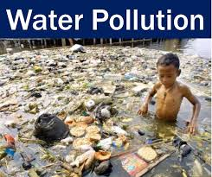
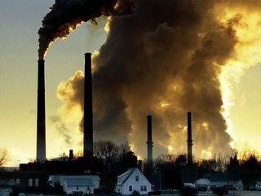
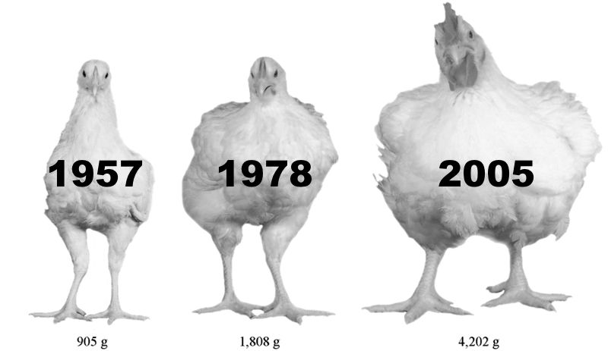
Role of chemistry in environmental problems
Air Pollution
Genetic modification

Slide 4
Roots of Green Chemistry in Pollution Prevention Act 1990
To stop creating pollution in the first place became America's official policy in 1990 with the Federal Pollution Prevention Act .
Reduces the amount of any hazardous substance, pollutant, or contaminant entering any waste stream or otherwise released into the environment (including fugitive emissions) prior to recycling, treatment, or disposal.
The term "source reduction" includes:
Modifications to equipment or technology
Modifications to process or procedures
Modifications, reformulation or redesign of products
Substitution of raw materials

Slide 5
Why do we need Green Chemistry
Prevents pollution at the molecular level
Is a philosophy that applies to all areas of chemistry, not a single discipline of chemistry
Applies innovative scientific solutions to real-world environmental problems
Results in source reduction because it prevents the generation of pollution
Reduces the negative impacts of chemical products and processes on human health and the environment
Lessens and sometimes eliminates hazard from existing products and processes
Designs chemical products and processes to reduce their intrinsic hazards

Slide 6
Goals and Objectives of Green Chemistry
To reduce the adverse environmental impacts, try innovative and appropriate choice of chemicals
To develop process renewable rather than non renewable raw materials
To develop processes that are less prone to obnoxious chemical release, fire and explosion
To minimize by-products in chemical transformation by redesigning of chemical processes
To develop processes that are less toxic
To develop products that degrade more rapidly in environments
Contd

Slide 7
7. To reduce the requirements of hazardous and persistent solvents and extractants
8. To improve energy efficiency of processes
9. To develop efficient and reliable methods to monitor the processes

Slide 8
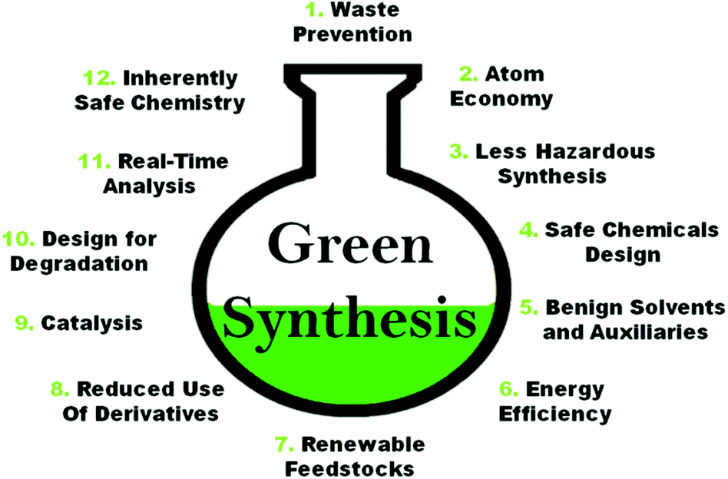
12 principles of Green Chemistry

Slide 9
1. Prevention of waste
It is better to prevent waste than to treat or clean up waste after it is formed.
Reactant A + Reactant B-----------> Product C + Waste D
Green chemist looks at pollution prevention at molecular level, so instead of generating the waste, focus will be on finding the alternate root of getting product without producing waste.
Reactant 1 + Reactant 2 -----------> Product C

Slide 10
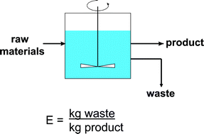
Environment Factor (E-factor) concept has played a major role in focusing the attention on the problem of waste generation in electronic manufacture.
To manufacture computer chips, many chemicals, large amounts of water, and energy are required. In a study conducted in 2003, the industrial estimate of chemicals and fossil fuels required to make a computer chip was a 630:1 ratio!

Slide 11
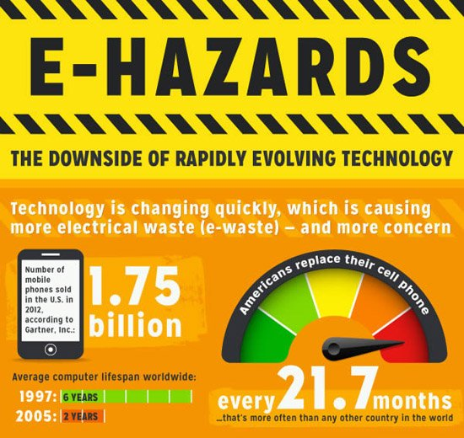
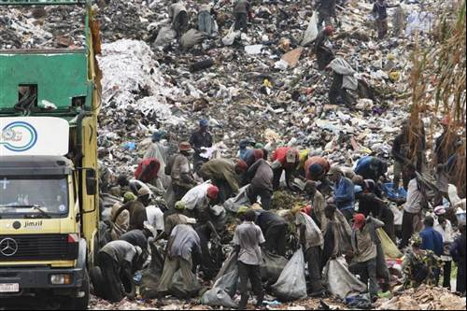
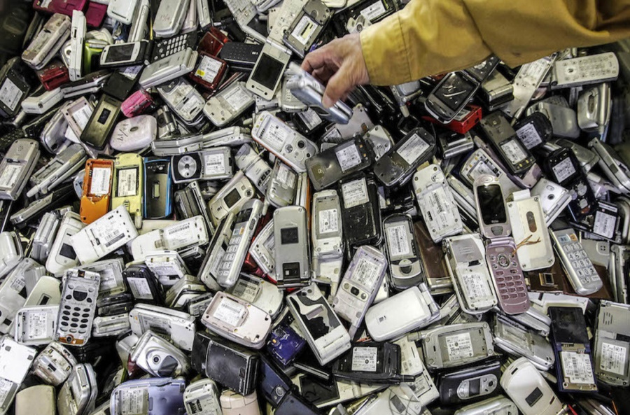
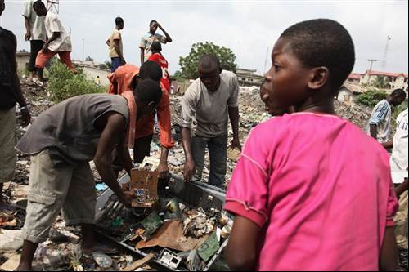

Slide 12
Serious proposals to reduce e-waste must address how electronics are manufactured in the first place. Some ways to do that include designing electronics that are more durable, repairable and recyclable.
Second big question is of consumer behavior.
How many of our digital upgrades result from genuine obsolescence versus fashion?
Stanford engineer Zhenan Bao and her team created a flexible electronic device that can easily degrade just by adding a weak acid like vinegar, according to a paper published in National Academy of Sciences.

Slide 13
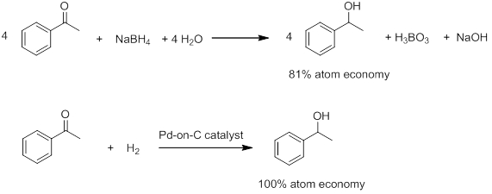
2. Atom Economy

Slide 14
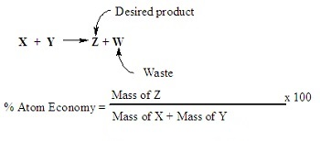
Increase Atom Economy
The concept of Atom Economy was developed by Barry Trost of Stanford University (US), for which he received the Presidential Green Chemistry Challenge Award in 1998. It is a method of expressing how efficiently a particular reaction makes use of the reactant atoms.
Atom economy = Relative formula mass of useful product x 100
Relative formula mass of the reactants used

Slide 15
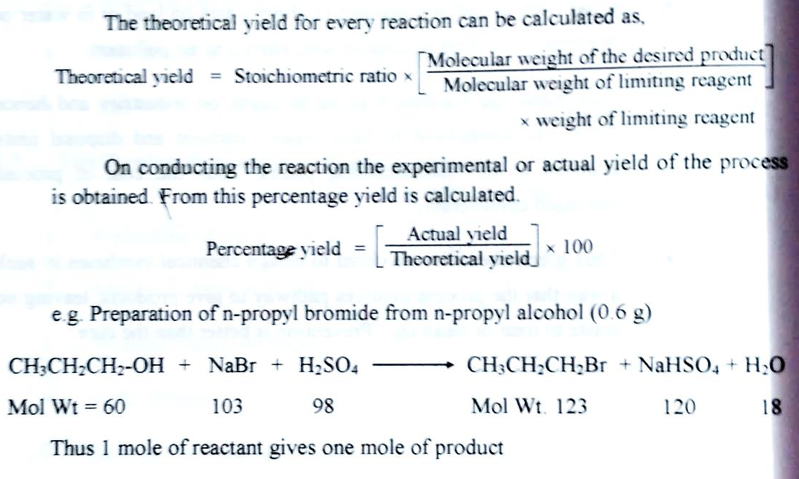

Slide 16
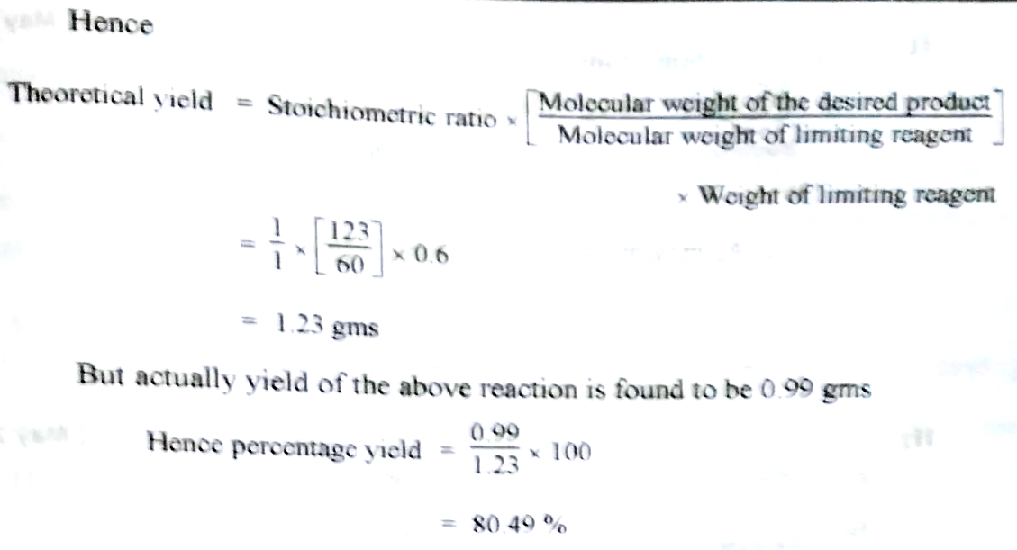

Slide 17
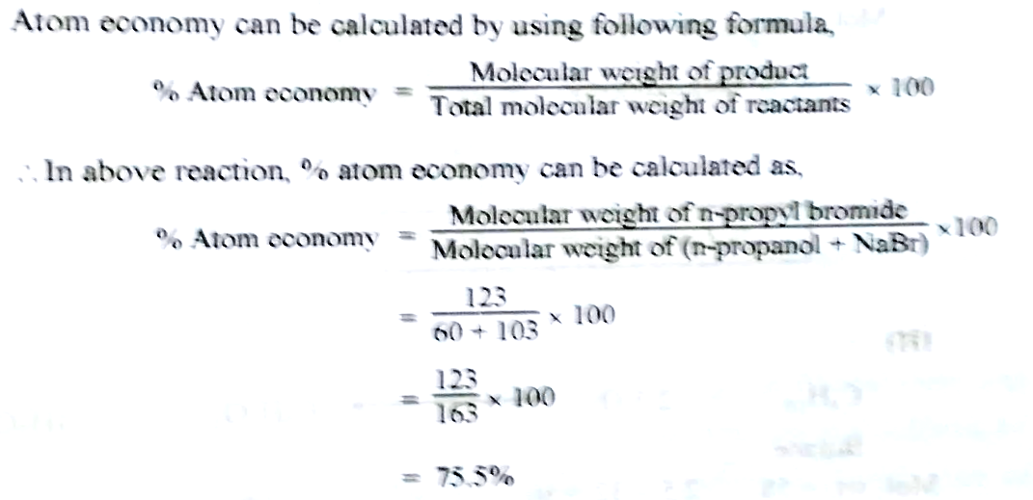

Slide 18
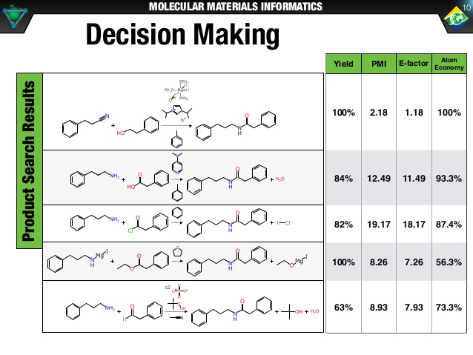

Slide 19
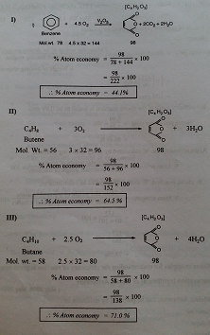
Atom Economy- Example: Preparation of Maleic anhydride from- Benzene Butene Butane

Slide 21
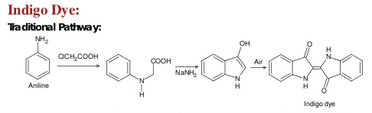
3. Non Hazardous Synthesis
Wherever practicable, synthetic methods should be designed to use and generate substances that possess little or no toxicity to human health and the environment.

Slide 22
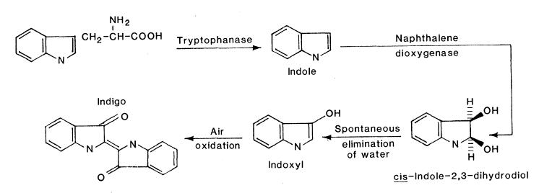
Green Synthesis of Indigo

Slide 23
4. Safer Chemicals and Product
For reducing the toxicity, the efficiency of desired product should be preserved
Chemical products should be designed to carry out their desired function, while minimizing their toxicity.
Mastering the art and science of toxicology requires innovative approaches to chemical characterization that state that hazard is a design flaw and must be addressed at the genesis of molecular design. The intrinsic hazard of elements and molecules is a fundamental chemical property that must be characterized, evaluated and managed as part of a systems-based strategy for chemical design.

Slide 24
There are two crucial elements in approaching the goal of sustainability in chemical products and processes: alternatives assessment and molecular design. To date the focus is on the first point.
Determining the toxicity of chemicals is necessary to identify their harmful effects on humans, animals, plants, or the environment. It is also one of the main steps in drug design. Animal models have been used for a long time for toxicity testing. However, in vivo animal tests are constrained by time, ethical considerations, and financial burden. Therefore, computational methods for estimating the toxicity of chemicals are considered useful. Computational methods to analyze, simulate, visualize, or predict the toxicity of chemicals.

Slide 25
5. Use of safer Solvents
The solvents and separating agents should not be used unnecessarily
Acetone, ethers and most of organic solvents are inflammable and are avoided
Chloroform, carbon tetrachloride and many other chlorinated solvents are toxic and carcinogenic
If solvents are necessary water is good medium or some ecofriendly solvents like Supercritical CO2 can be used.

Slide 26
6. Energy Efficiency
The aim of green chemistry is to increase energy efficiency
This can be achieved by use of catalyst and by stopping the use of fossils fuels.
Microwave and sound waves are new alternate types of energy substitute for efficient energy processes.
The energy efficiency can be increased by
a) Proper heat transfer
b) minimal wastage of energy during the process.

Slide 27
7. Renewable Feedstock
Adipic acid is required in large quantity as raw material for the synthesis of nylon and lubricants.
But Adipic acid is prepared from benzene which is toxic and carcinogenic. Also during synthesis nitrous acid is used which is a green house gas
Green synthesis of adipic acid uses D-Glucose as a raw material which is both non-toxic as well as renewable feedstock

Slide 28
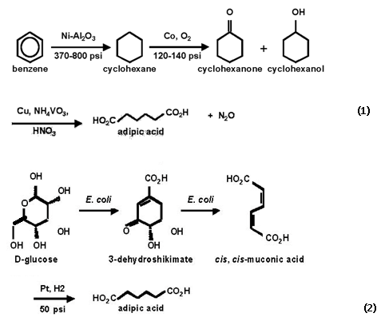
Synthesis of adipic acid
Traditional Method:
Alternate Synthesis:

Slide 29
8. Avoid chemical derivatives
Unnecessary derivatization or temporary modifying should be avoided.
Derivatives increases the steps and reduces the atom economy
Additional reagents are required and generates more steps
Example
Synthesis of Ibuprofen in which traditionally large number of steps are involved and atom economy is only 40%
Whereas in alternative route product form more selectively and less number of steps. The atom economy of synthesis is 77 %

Slide 30
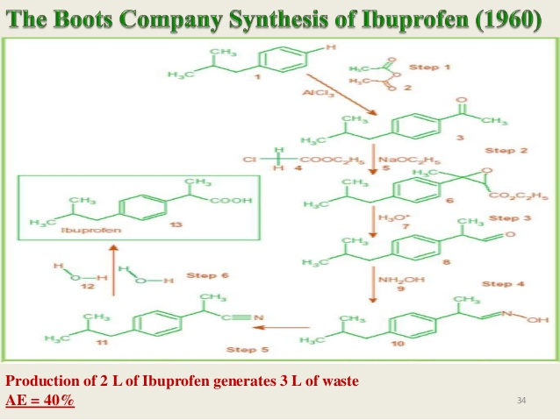

Slide 31
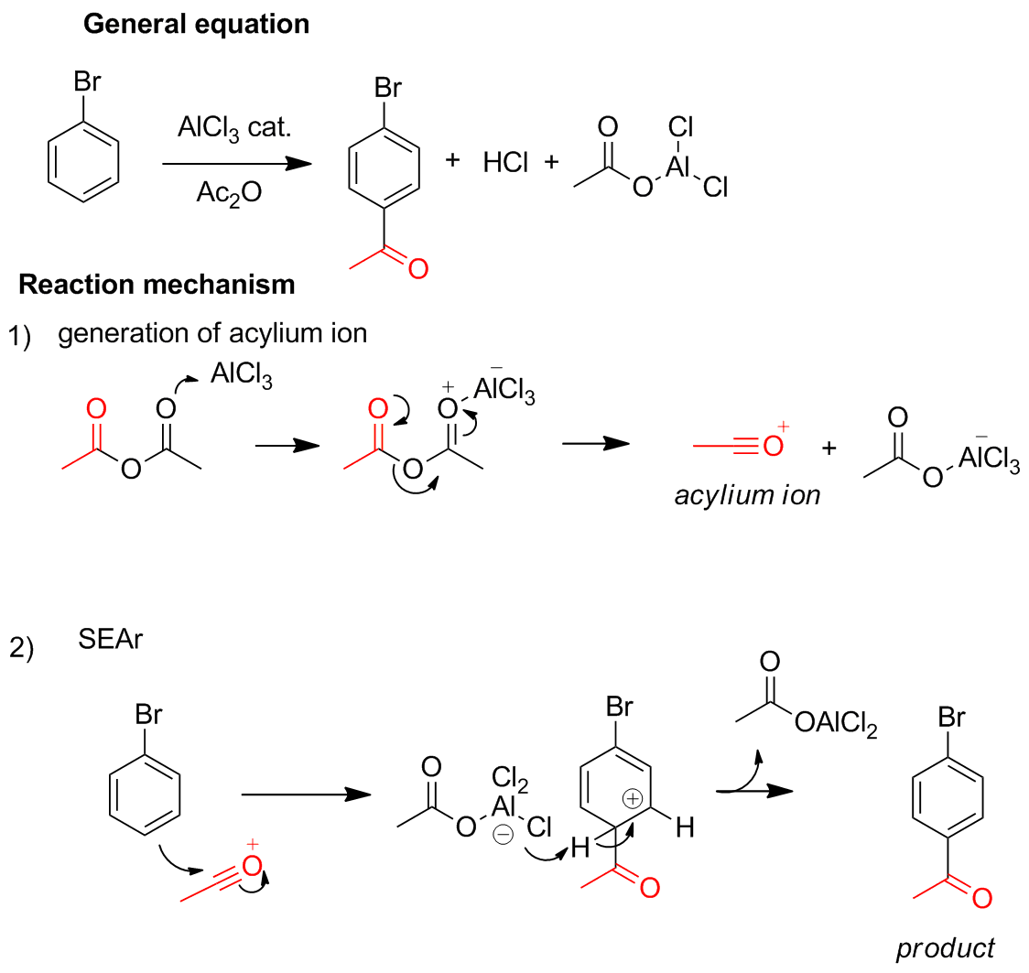

Slide 32
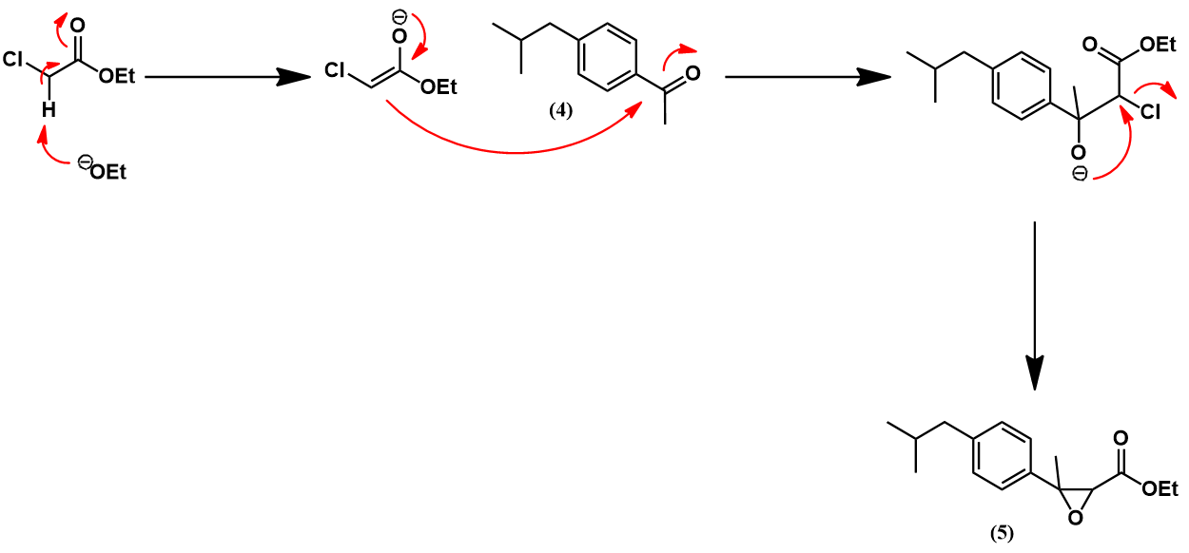

Slide 33
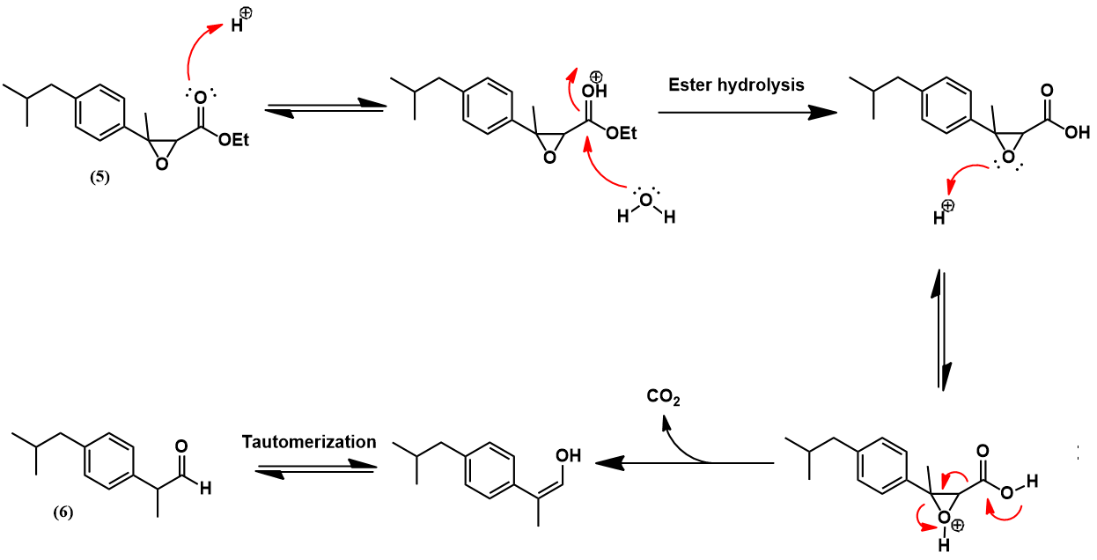

Slide 34
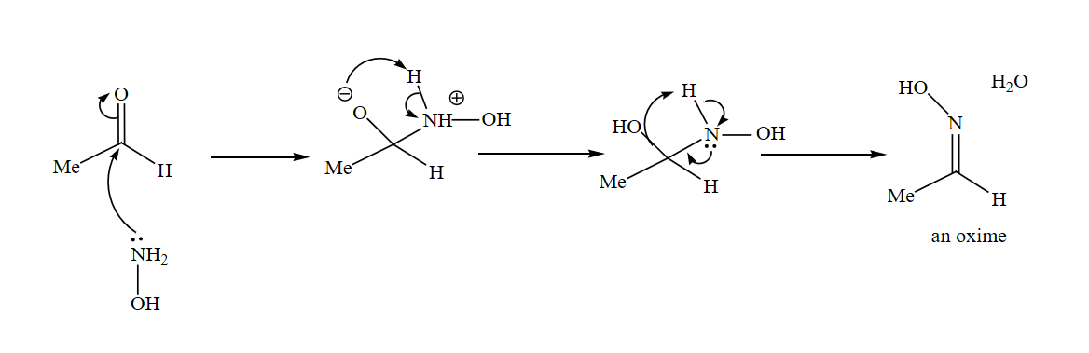
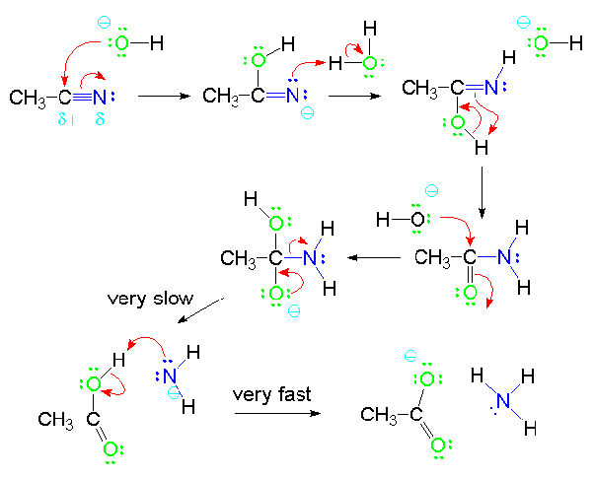

Slide 35
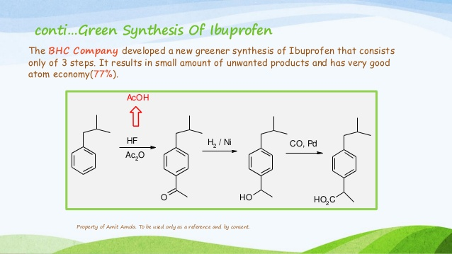

Slide 36
9. Catalysis
Catalytic reagents (as selective as possible) are superior to stoichiometric reagents.
Catalyst facilitates transformation without being consumed or without being incorporated into the final product.
Catalysts are selective in their action in that the degree of reaction that takes place is controlled, e.g. mono addition v/s multiple addition.

Slide 37
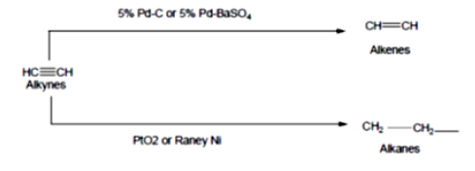
Example is that reduction of triple bond to a double bond or single bond.
In addition to the benefits of yield and atom economy, the catalysts are helpful in reducing consumption of energy.
Catalysts can be recycled and reused.
Catalytic reactions are faster and hence require less energy. They are preferable to stoichiometric reagents, which are used in excess and work only once.
In recent years many processes are been developed which use non-toxic recoverable catalysts and also biocatalysts.

Slide 38
Heterogeneous vs Homogenous
Distinct solid phase
Readily separated
Readily regenerated & recycled
Rates not as fast
Diffusion limited
Sensitive to poisons
Lower selectivity
Long service life
High energy process
Poor mechanistic understanding
Same phase as rxn medium
Difficult to separate
Expensive and/or difficult to separate
Very high rates
Not diffusion controlled
Robust to poisons
High selectivity
Short service life
Mild conditions
Mechanisms well understood
Green
catalyst

Slide 39
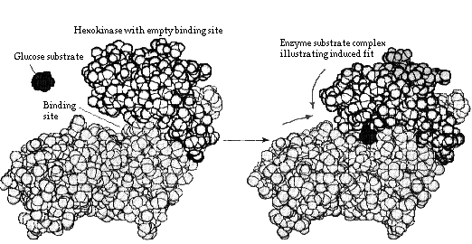
Bio-catalysis
Enzymes or whole-cell micro-organisms
Benefits
Fast rxns due to correct orientations
Orientation of site gives high stereospecificity
Substrate specificity
Water soluble
Naturally occurring
Moderate conditions
Possibility for tandem rxns (one-pot)

Slide 40
10. Design for Degradation
Chemical products should be designed so that at the end of their function they do not persist in the environment and instead break down into innocuous degradation products.
Sulfonated detergents
Alkylbenzene sulfonates – 1950’s & 60’s
Foam in sewage plants, rivers and streams
Persistence was due to long alkyl chain
Introduction of alkene group into the chain increased degradation
Chlorofluorocarbons (CFCs)
Do not break down, persist in atmosphere and contribute to destruction of ozone layer
DDT
Bioaccumulate and cause thinning of egg shells
DDT when used as pesticide, its residues remains in soil for many years causing pollution. The alternative to this is biological insecticides

Slide 41
Degradation of Polymers:
Polylactic Acid
Manufactured from renewable resources
Corn or wheat; agricultural waste in future
Uses 20-50% fewer fossil fuels than conventional plastics
PLA products can be recycled or composted

Slide 42
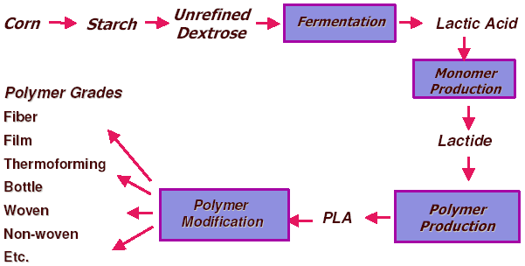
Poly lactic acid (PLA) for plastics production
Examples of Green Catalysis

Slide 43
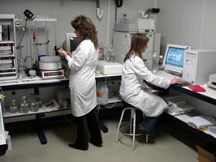
11. Real Time Analysis
Analytical methodologies need to be further developed to allow for real-time in-process monitoring and control prior to the formation of hazardous substances.
What do you need to know, how do you get this information and how long does it take to get it?
Knowing when your product is “done” can save a lot of waste, time and energy!

Slide 44
Methods and technologies should be developed so that the prevention or minimization of generation of hazardous waste is achieved.
It is necessary to have accurate and reliable reasons, monitors and other analytical methodologies to assess the hazardous that may be present in the process stream.
These can prevent any accidents which may occur in chemical plants.
Example- Preparation of ethylene glycol, in which if reaction conditions are not monitored perfectly, toxic substances are produced at higher temperature.

Slide 45
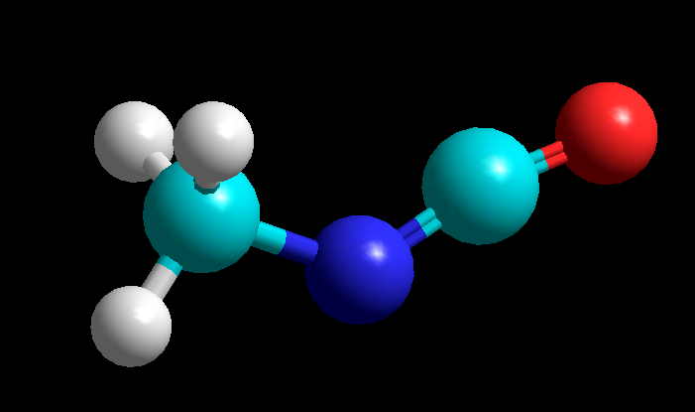
12. Inherently Safe Chemistry
Substance and the form of a substance used in a chemical process should be chosen so as to minimize the potential for chemical accidents, including releases, explosions, and fires.
Tragedy in Bhopal, India – 1984: worst industrial accident in history.
Methyl isocyanate
Chemists try to avoid things that explode, light on fire, are air-sensitive, etc.
In the “real world” when these things happen, lives are lost.

Slide 46
December 3, 1984 – 40 tons of poison gas leaked from a Union Carbide factory, killing thousands instantly and injuring many more (many of who died later of exposure). Up to 20,000 people have died as a result of exposure (3-8,000 instantly). More than 120,000 still suffer from ailments caused by exposure
What happened?
Methyl isocyanate – used to make pesticides was being stored in large quantities on-site at the plant
Methyl isocyanate is highly reactive, exothermic molecule
Most safety systems either failed or were inoperative
Water was released into the tank holding the methyl isocyanate
The reaction occurred and the methyl isocyanate rapidly boiled producing large quantities of toxic gas.

Slide 47
Green Solvents
Solvents are substances that are liquid during application and will dissolve other substances, which can be recovered unchanged on removal of solvents.
Selection of solvent should be based not only on any hazards that it may possess but also on existing environmental problems that its use may cause.
Solvents define a major part of the environmental performance of processes in chemical industry and also impact on cost, safety and health issues.
The idea of ‘green’ solvent expresses the goal to minimize the environmental impact resulting from the use of solvents in chemical production.

Slide 48
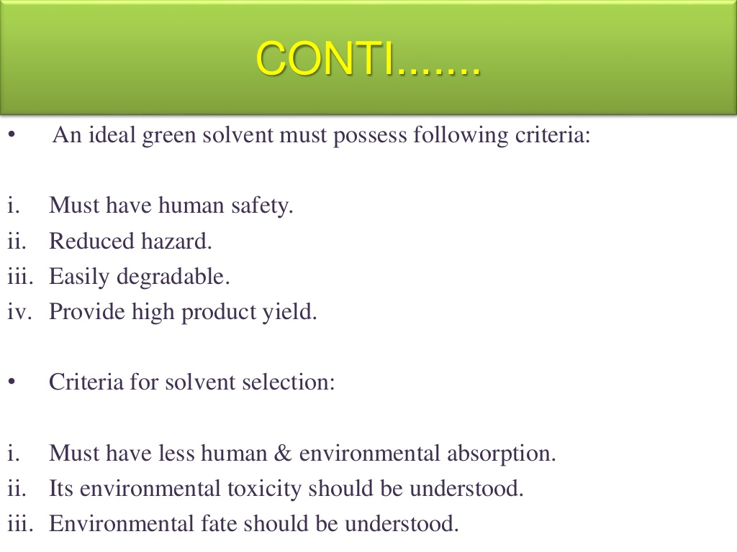

Slide 49
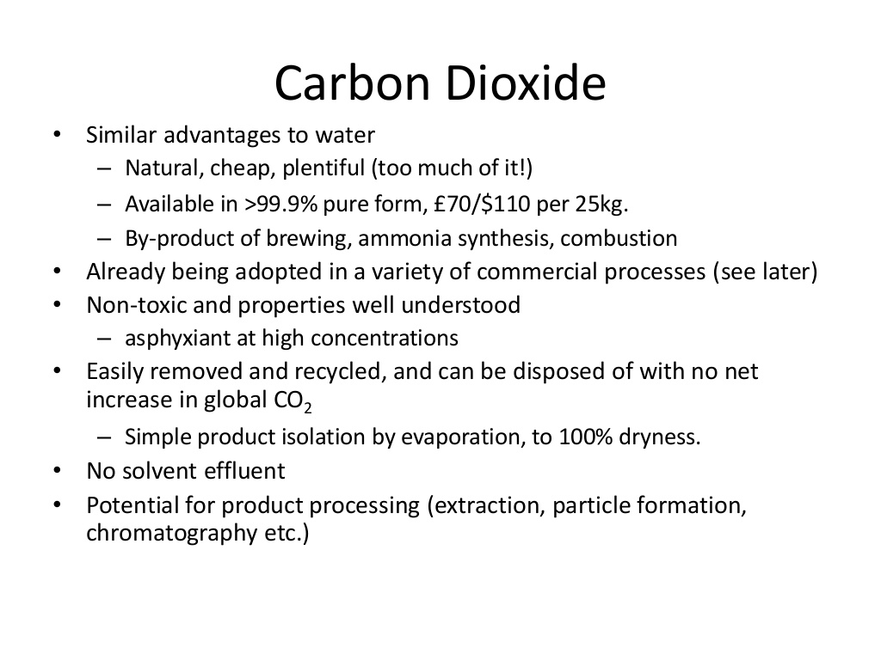

Slide 50
SUPERCRITICAL FLUIDS
Above its critical values, a compound’s liquid-vapor phase boundary no longer exists and its fluid properties can be tuned by adjusting the pressure or temperature.
Although supercritical fluid has liquid-like density, it exhibits gas-like diffusivity, surface tension and viscosity. Its gas-like viscosity results in high mass transfer. Its low surface tension and viscosity lead to greater penetration into porous solids. Because of its liquid-like density, a supercritical fluid’s solvent strength is comparable to that of a liquid.
The critical temperatures and pressures of materials vary quite significantly. Generally, substances that are very polar at room temperature will have high critical temperatures since a large amount of energy is needed to overcome the polar attractive energy.

Slide 51
At critical conditions, the molecular attraction in a supercritical fluid is counterbalanced by the kinetic energy. In this region, the fluid density and density-dependent properties are very sensitive to pressure and temperature changes.
The solvent power of a supercritical fluid is approximately proportional to its density. Thus, solvent power can be modified by varying the temperature and pressure. Because their properties are a strong function of temperature and pressure, supercritical fluids are considered tunable solvents.
In contrast, conventional liquid solvents require relatively large pressure changes to affect the density.

Slide 52
Many reactions, extractions, separations and other operations in the chemical process industries (CPI) involve the use of organic solvents. In addition to handling and disposal issues, organic solvents can pose a number of environmental concerns, such as atmospheric and land toxicity. In many cases, conventional organic solvents are regulated as volatile organic compounds (VOCs). In addition, certain organic solvents are under restriction due to their ozone-layer-depletion potential.
Supercritical carbon dioxide is an attractive alternative in place of traditional organic solvents. CO₂ is not considered a VOC. Although CO₂ is a greenhouse gas, if it is withdrawn from the environment, used in a process, and then returned to the environment, it does not contribute to the greenhouse effect. There have been an increasing number of commercialized and potential applications for supercritical fluids.

Slide 53
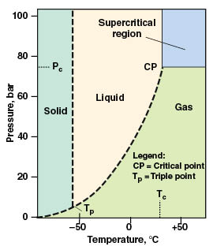
SUPERCRITICAL CO₂ PROPERTIES
Unlike many organic solvents, supercritical CO₂ is non-flammable. It is inert, non-toxic, has a relatively low cost and has moderate critical constants. Its solvation strength can be fine-tuned by adjusting the density of the fluid. CO₂ leaves a lower amount of residue in products compared to conventional solvents, and it is available in relatively pure form and in large quantities.
CO₂’s critical temperature (T_{c}; 32.1°C) is near ambient, making it an attractive solvent for temperature-sensitive materials. CO₂’s critical pressure is 73.8 bar (P_{c}; 1,070 psi), as shown in its phase diagram.
The phase diagram for carbon dioxide shows its supercritical region

Slide 54
EXTRACTIONS USING CO₂
Currently, the widest application of supercritical CO₂ is in extraction. Total CO₂ consumption in supercritical extraction processes is estimated to have been approximately 15,000 to 25,000 ton/yr in 1994 and between 30,000 and 35,000 tons in 2002. Worldwide, over 100 facilities are estimated to use dense CO₂ for extraction and purification. Large-scale commercial plants using supercritical CO₂ extraction are found in the food industries (Table 2).
Table 2. Commercial-Scale Supercritical- CO2 Extraction Plants and Processes
Process | Location | Manufacturer
Coffee decaffeination | Houston, Tex., U.S. | Maximus Coffee Group LP (formerly General Foods)
 | Bremen, Germany | Kaffe HAG AG
 | Bremen, Germany | Hermsen
 | Poszillo, Italy | SKW-Trostberg AG
Tea decaffeination | Munchmuenster, Germany | SKW-Trostberg AG
Fatty acids from spent barley | Dusseldorf, Germany | Marbery, GmbH
Vitamin E oil, phytosterol, fatty acid methyl ester, ginger oil | Wuhan, Hubei, China | Wuhan Kaidi Fine Chemical Industrial Co.
Nicotine extraction | Hopewell, Va., U.S. | Philip Morris
Natural insecticide/pesticide (Pyrethrum extract) | High Wycombe, U.K. | Agropharm

Slide 55
Conventional processes for extracting various components from food products have limitations regarding the solvent toxicity, flammability and wastefulness. This area is where early commercial applications of supercritical CO₂ were focused. The relatively low critical temperature and low reactivity of CO₂ allow extraction without altering or damaging the product. Decaffeination of coffee was one of the first processes commercialized using supercritical CO₂.
The extraction process. Extraction of food and natural products with supercritical CO₂ consists of two steps: first, the extraction of supercritical CO₂ soluble components from the feed; and, second, the separation of the components from supercritical CO₂. The separation of supercritical CO₂ from the extract can be done by either modifying the thermodynamic conditions or by using an external agent. By modifying the thermodynamic conditions via changing the pressure or temperature, the solvent power of CO₂ is changed. If an external agent is used, separation is carried out by adsorption or absorption. If separation occurs with an external agent, no significant pressure change occurs. Therefore, the operating cost that is associated with pressure requirement is lower.

Slide 56
Recent extraction applications. There has been a great deal of interest in supercritical CO₂ extraction beyond caffeine extraction, particularly in the preparation of high value products, such as flavors and fragrances, food supplements and nutraceuticals.
Specialty oils, for example, are high in value and typically low in volume. They have high concentrations of bioactive lipid components that are valued because of various possible health benefits. Herbal extracts from a wide range of botanical raw materials are used as ingredients to the food-and-flavor, nutraceuticals, pharmaceuticals and the cosmetics industries. Supercritical CO₂ extraction can also be used to purify materials that are used for the production of medical devices.

Slide 57
Chemical reactions. Supercritical CO₂ has been tested in a variety of industrially important reactions, such as alkylations, hydroformylations, and hydrogenation, as an alternative reaction medium.
The incentives to use supercritical CO₂ as reaction medium can include (a) replacement of the conventional organic solvent with a “green” solvent, (b) improved chemistry such as reactivity and selectivity, (c) new chemistry, and (d) improved separation and recovery of products and catalysts. Relatively high rates of molecular diffusion and heat transfer are possible with a homogenous, supercritical-CO₂ reaction-medium.
Limitations to the use of supercritical CO₂ as a reaction medium include (a) poor solubility of polar and high-molecular-weight species, (b) no observed improvement in reaction chemistry in some cases, and (c) higher capital investment cost due to higher operating pressures. For reactions not limited by reactant-gas concentrations or other mass-transfer limitations, there is no improvement in reactivity observed when using a homogeneous, supercritical CO₂ medium.

Slide 58
Polymer production and processing. Applications of supercritical CO₂ in polymers include polymerization, polymer composite production, polymer blending, particle production, and microcellular foaming. Several applications, particularly those involving low pressures, have been successfully commercialized.
One example of this application area is a process to produce fluoropolymers using supercritical CO₂ as the reaction medium that was developed by scientists at the University of North Carolina (Chapel Hill). DuPont had an exclusive license for this process until 2015. A $40-million pilot plant was built in 2000 to produce fluoropolymers using this process technology. The pilot plant is capable of producing 1,100 metric tons per year (m.t./yr) of fluoropolymers. Several grades of melt-processable fluoropolymers produced from this process became commercially available in 2002.

Slide 59
Semiconductor processing. Currently, chip manufacturing involves many wet-chemical processes that use hydroxyl amines, mineral acids, elemental gases, organic solvents and large amounts of high purity water during chip fabrication. One potential application is the use of supercritical CO₂ in wafer processing. The low viscosity and surface tension of supercritical CO₂ allow for efficient cleaning of small feature sizes, which is of great importance with the continued miniaturization of integrated circuits. However, the main obstacle to the use of supercritical CO₂ in semiconductor cleaning is the high cost.
Powder production. One promising application for supercritical CO₂ is the production of micro- and nano-scale particles. The pharmaceutical industry currently uses supercritical CO₂ mainly to control the powder particle size of products during synthesis.
The use of supercritical CO₂ for micronization of pharmaceutical compounds has several potential advantages over conventional techniques such as spray drying, jet milling and grinding.
These advantages include minimum product contamination, reduced waste streams, suitability for the processing of thermally, shock or chemically sensitive compounds and the possibility of producing particles with narrow size distribution in a single-step operation.

Slide 60
DMC
Carbonic esters, such as DMC- dimethyl carbonate (CH3OCOOCH3) are considered a new class of “green” solvents in many organic reaction processes.
They can replace methychlorides and dimethyl sulphate esters which are toxic and hazardous.
DMC can be used in methylation reactions of phenols, anilines and carboxylic acids.
The reactivity of DMC is tunable: at T ≤ 90 °C, methoxycarbonylations take place, while at higher reaction temperatures, methylation reactions are observed with a variety of nucleophiles. Besides, DMC-mediated methylations are catalytic reactions which use safe solids (alkaline carbonates) avoiding the formation of undesirable inorganic salts as byproducts. The high selectivity in methylation reactions is due to the ambident electrophilic character of DMC which reacts on its hard centre (the carbonyl group) with harder nucleophiles and on its soft one (themethyl group) with softer nucleophiles, according to the Hard-Soft Acid and Base (HSAB) theory.

Slide 61
DMC is produced by oxidative carbonylation of methanol with oxygen through a process developed by Enichem (Italy).
The most relevant features of this process are: • low-cost and widely available raw materials with low toxicity; • high production rates; • non-toxic and easy disposable by-products (carbon dioxide and water) • high quality product.
2 CH₃ OH+CO+1/2O₂ ➝(CH₃ O)₂ CO+H₂ O(I)
The new technology does not produce any by-products that are difficult to dispose of. The DMC obtained has also low toxicity and ecotoxicity (biodegradability >90% at 28 days OECD 301C; acute toxicity for fish; no effect at 1000 mg/l OECD 203).

Slide 62
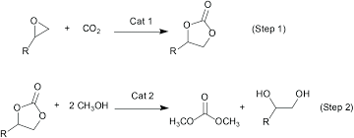
Another industrial procedure developed and recently industrialized in China is the cleavage of cyclic carbonates. Importantly, this synthesis doesn’t use any chlorine.

Slide 63
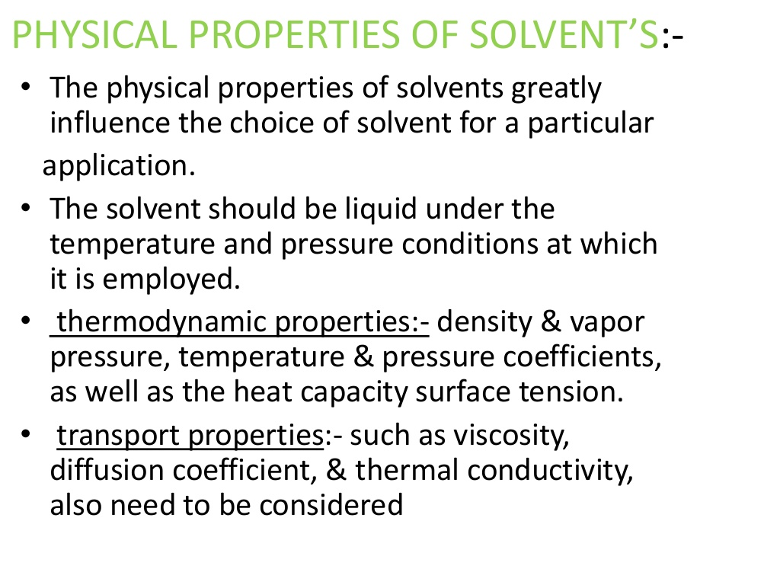

Slide 64
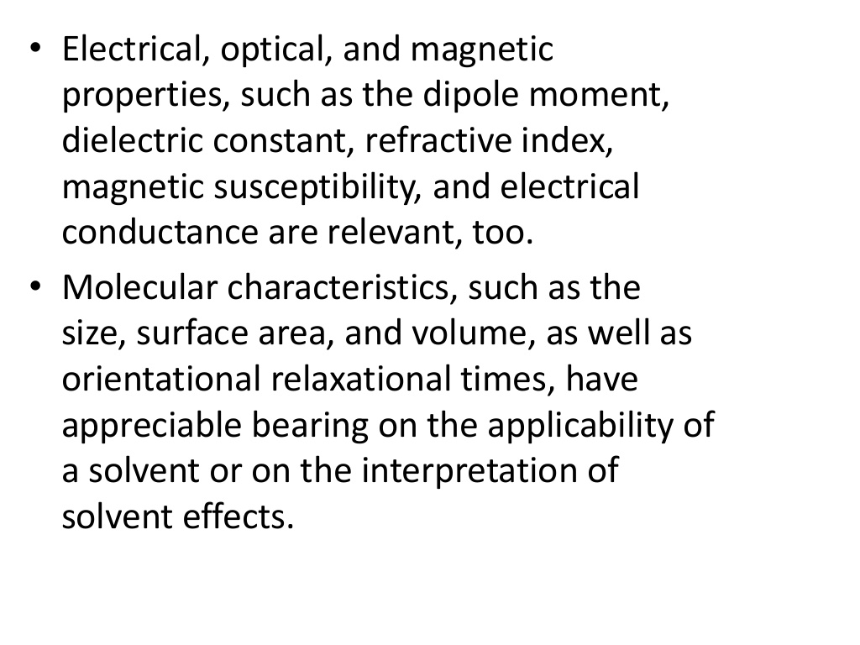

Slide 65
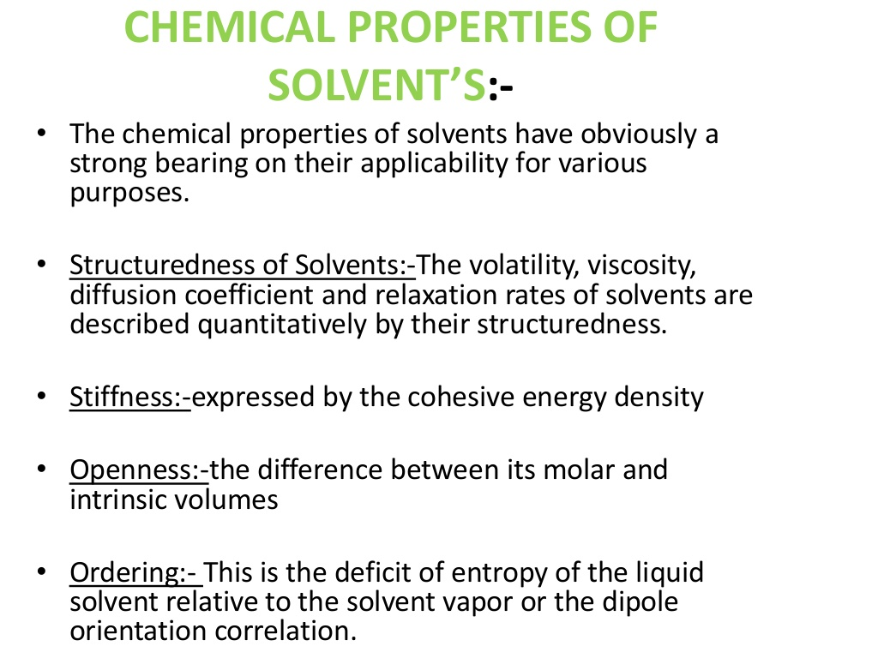

Slide 66
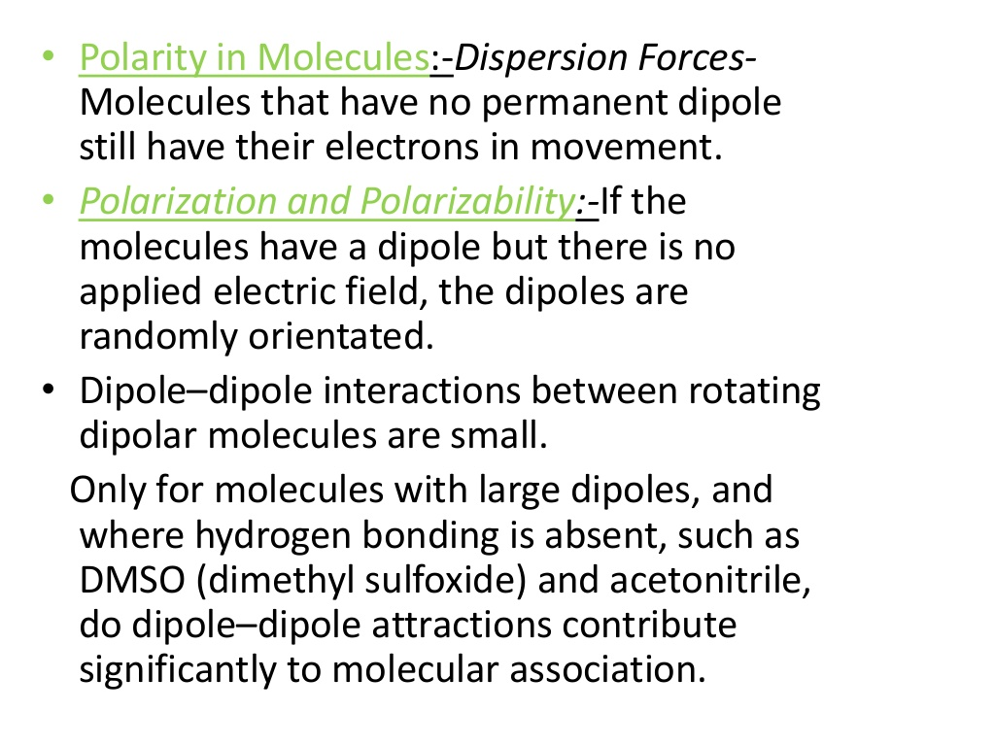

Slide 67
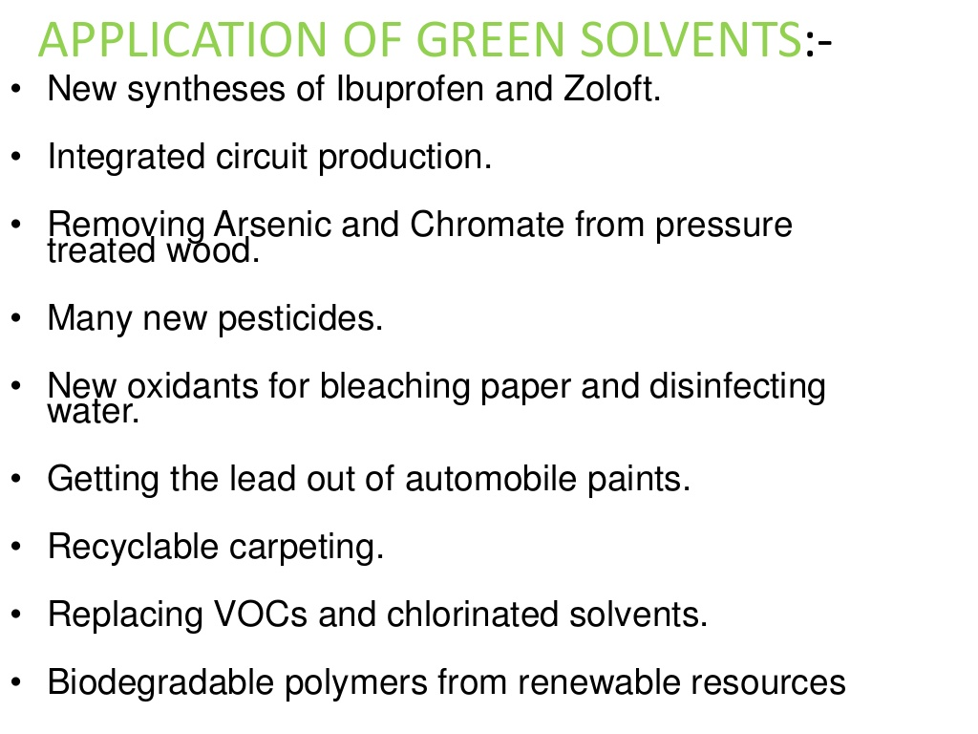

Slide 68
Numericals

Slide 70
Balancing chemical reaction/ equation
https://www.khanacademy.org/science/chemistry/chemical-reactions-stoichiome/balancing-chemical-equations/v/balancing-chemical-equations-introduction
https://www.youtube.com/watch?v=yZi9URUAWIc

